Slide 1
BAND PASS FILTER

Slide 2
BAND PASS FILTER
A band-pass filter has a passband between two cutoff frequencies f_{L} and f_{H} such that f_{H} > f_{L}.
Any frequency outside this passband is attenuated.
There are two types of band-pass filters:
wide band pass and narrow band pass.
Although there is no dividing line between the two, it is possible to identify them from the value of the fig. of merit or quality factor Q.

Slide 3
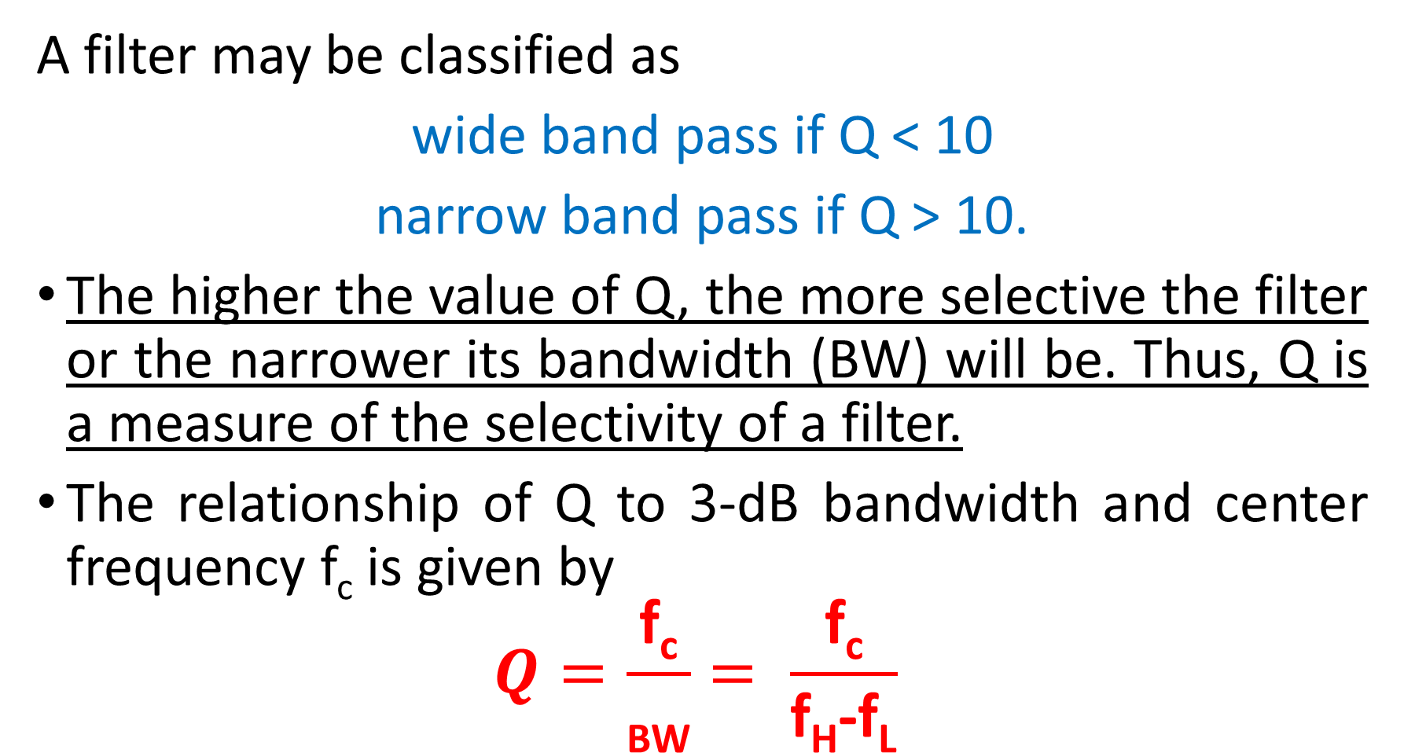
A filter may be classified as
wide band pass if Q < 10
narrow band pass if Q > 10.
The higher the value of Q, the more selective the filter or the narrower its bandwidth (BW) will be. Thus, Q is a measure of the selectivity of a filter.
The relationship of Q to 3-dB bandwidth and center frequency f_{c} is given by
$$Q=\frac{\text{f}\text{c}}{\text{BW}}= \frac{\text{f}\text{c}}{\text{f}\text{H}\text{−}\text{f}\text{L}}$$

Slide 4
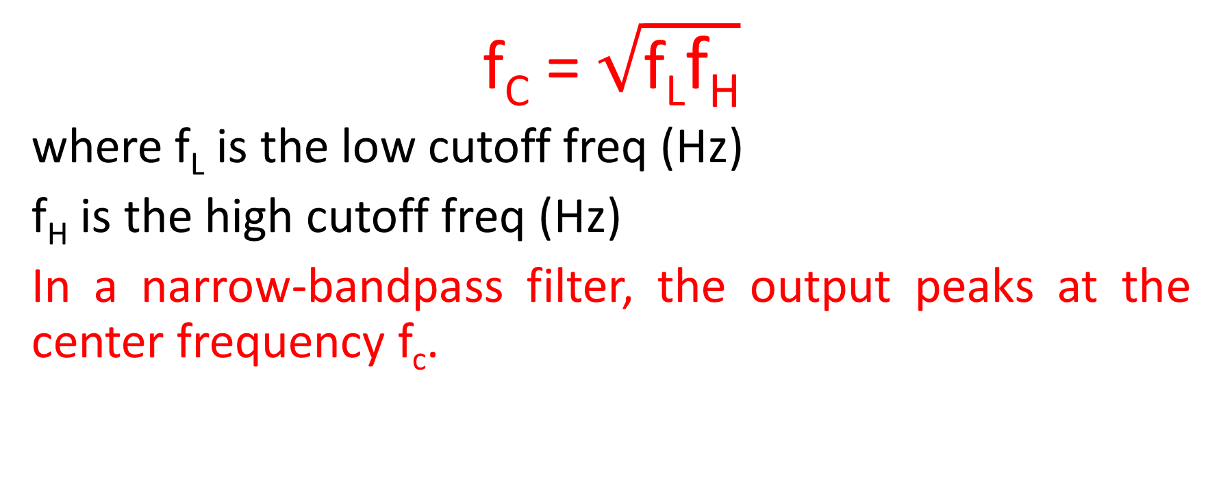
For a wide-band-pass filter, the center frequency f_{c} can be defined a
f_{C} = $\sqrt{\text{f}\text{L}\text{f}\text{H}}$
where f_{L} is the low cutoff freq (Hz)
f_{H} is the high cutoff freq (Hz)
In a narrow-bandpass filter, the output peaks at the center frequency f_{c}.

Slide 5
WIDE BAND PASS FILTER

Slide 6
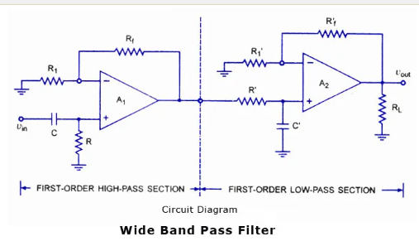
WIDE BAND PASS FILTER

Slide 7
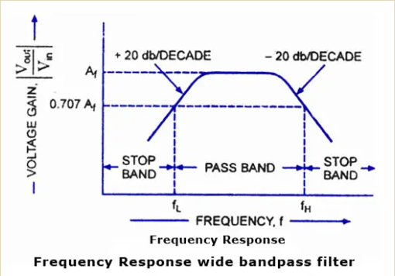

Slide 8
A wide bandpass filter can be formed by simply cascading high-pass and low-pass sections.
To form a ± 20 db/ decade bandpass filter, a first-order high-pass and a first-order low-pass sections are cascaded;
for a ± 40 db/decade bandpass filter, second-order high- pass filter and a second-order low-pass filter are connected in series, and so on.
It means that, the order of the bandpass filter is governed by the order of the high-pass and low-pass filters it consists of.

Slide 9
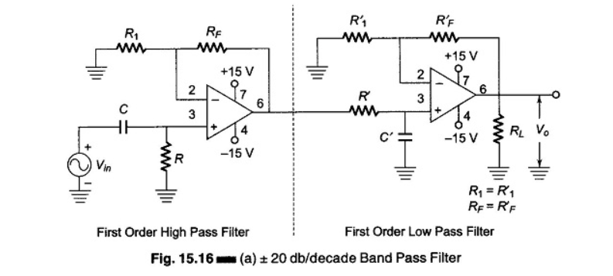

$1st order$Band pass filter

Slide 10
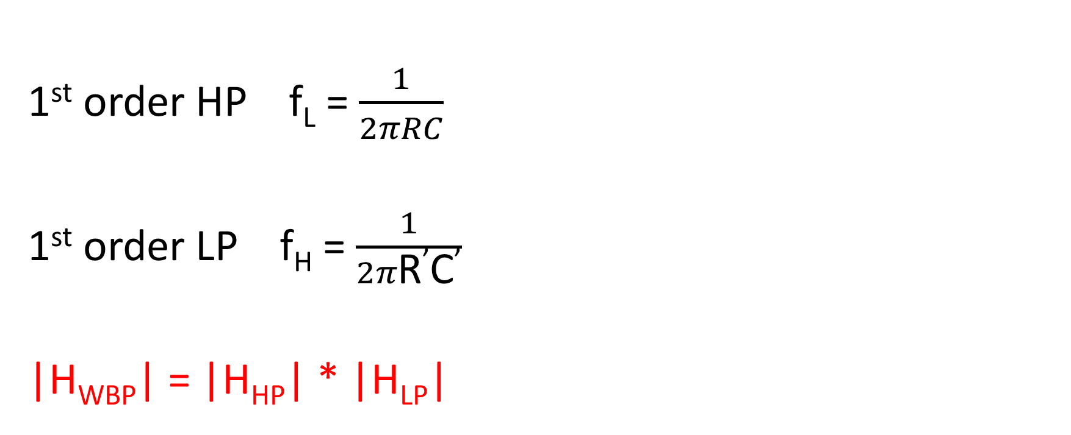
1st order HP f_{L} = $\frac{1}{2πRC}$
1st order LP f_{H} = $\frac{1}{2π\text{R}\text{’}\text{C}\text{’}}$
|H_{WBP}| = |H_{HP}| * |H_{LP}|

Slide 11
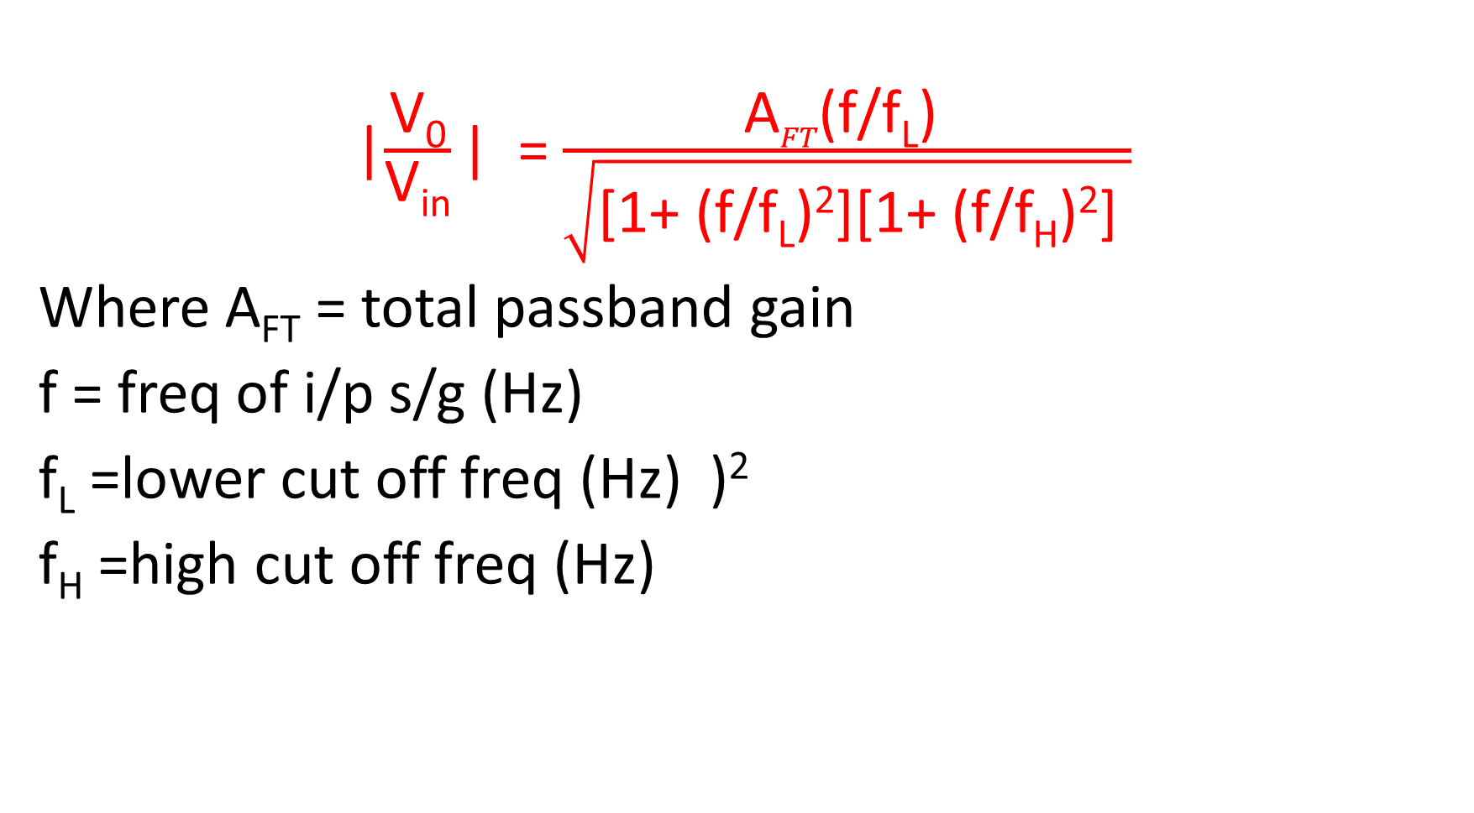
|$\frac{\text{V}\text{0}}{\text{V}\text{in}}$| = $\frac{\text{A}FT\text{(}\text{f}\text{/}\text{f}\text{L}\text{) }}{\sqrt{\text{[1+ (}\text{f}\text{/}\text{f}\text{L}\text{)}\text{2}\text{][1+ (}\text{f}\text{/}\text{f}\text{H}\text{)}\text{2}\text{] }}}$
Where A_{FT} = total passband gain
f = freq of i/p s/g (Hz)
f_{L} =lower cut off freq (Hz) )²
f_{H} =high cut off freq (Hz)

Slide 12
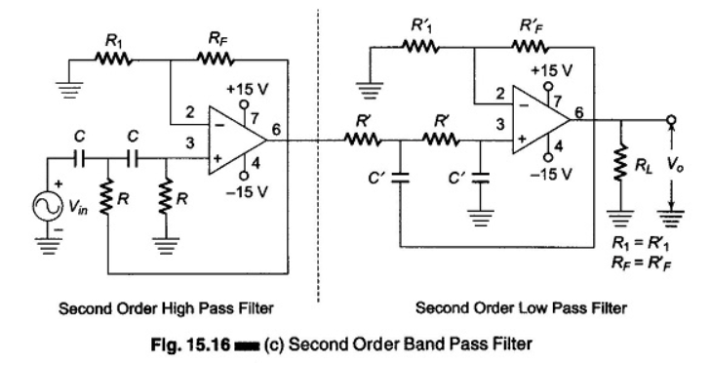
2nd order Band pass filter

Slide 13
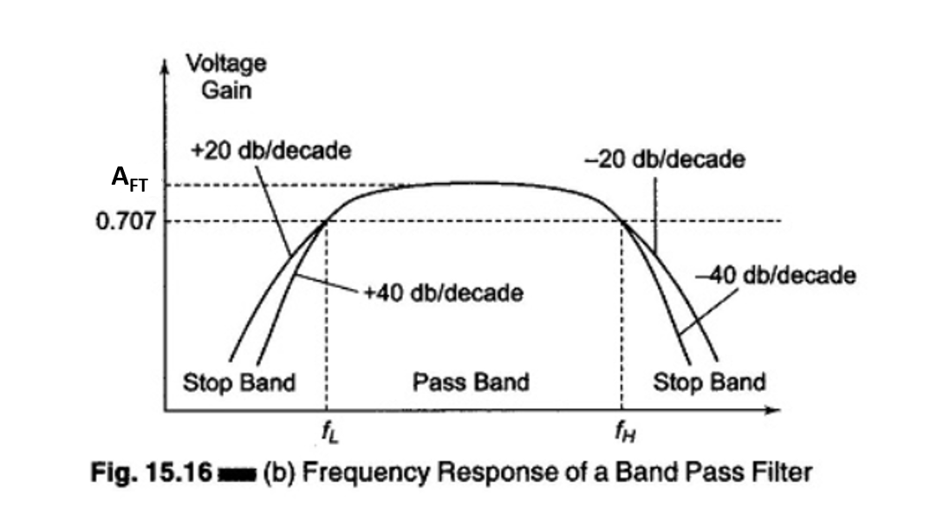

Slide 14
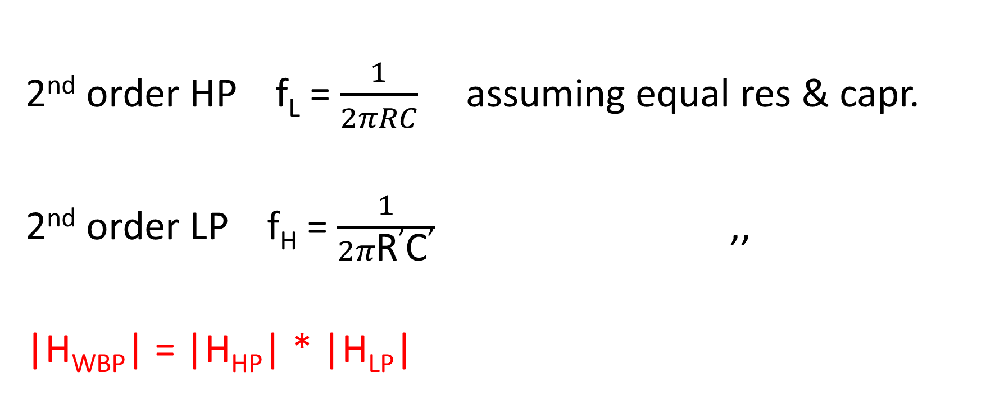
2nd order HP f_{L} = $\frac{1}{2πRC}$ assuming equal res & capr.
2nd order LP f_{H} = $\frac{1}{2π\text{R}\text{’}\text{C}\text{’}}$ ,,
|H_{WBP}| = |H_{HP}| * |H_{LP}|

Slide 15
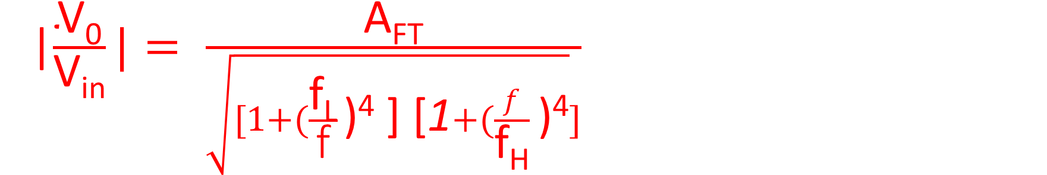
|$\frac{\text{V}\text{0}}{\text{V}\text{in}}|= \frac{\text{A}\text{FT}}{\sqrt{[1+(\frac{\text{f}\text{L}}{\text{f}} \text{)}\text{4} \text{]} \text{[}\text{1}+(\frac{f}{\text{f}\text{H}} \text{)}\text{4}}]}$
Where A_{FT} = total passband gain
f = freq of i/p s/g (Hz)
f_{L} =lower cut off freq (Hz)
f_{H} =high cut off freq (Hz)

Slide 16
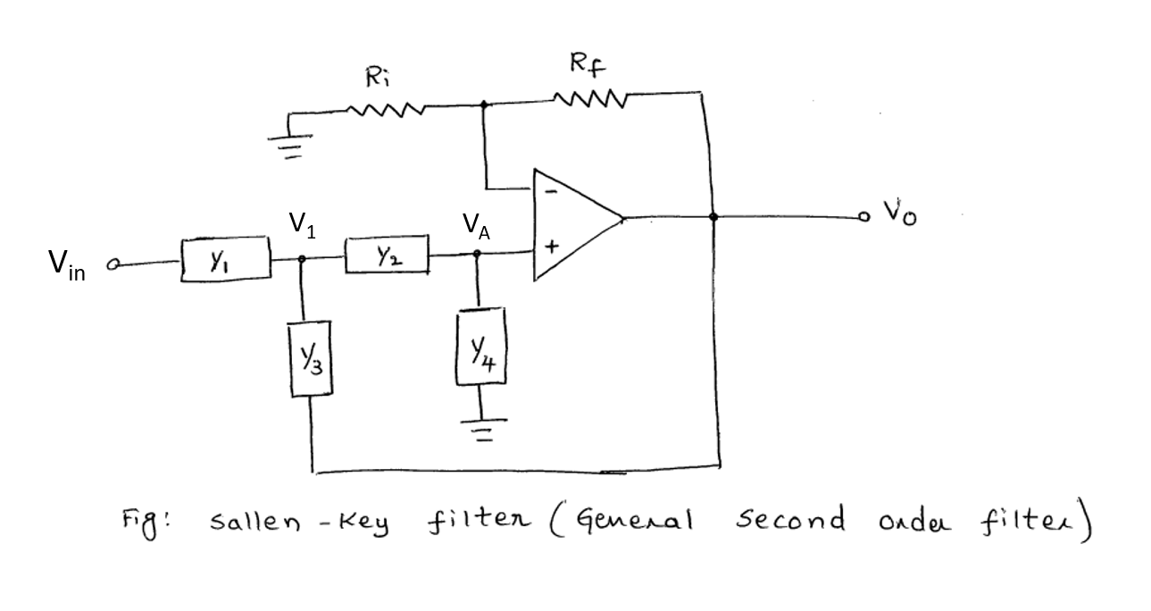

Slide 17
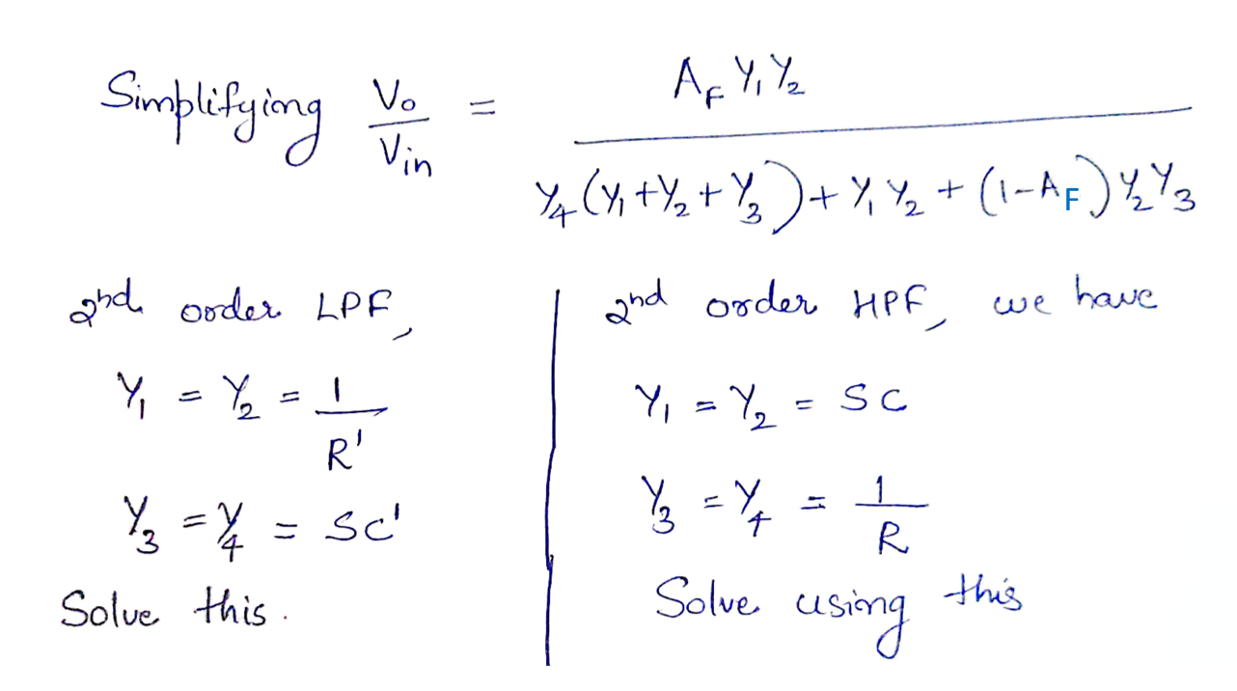

Slide 18
NUMERICALS
a) Design a wide band pass filter with f_{L} = 200 HZ, f_{H}=1 KHz and a pass band gain = 4.
b) Also plot the freq response.
c) Calculate Q for the filter.

Slide 19
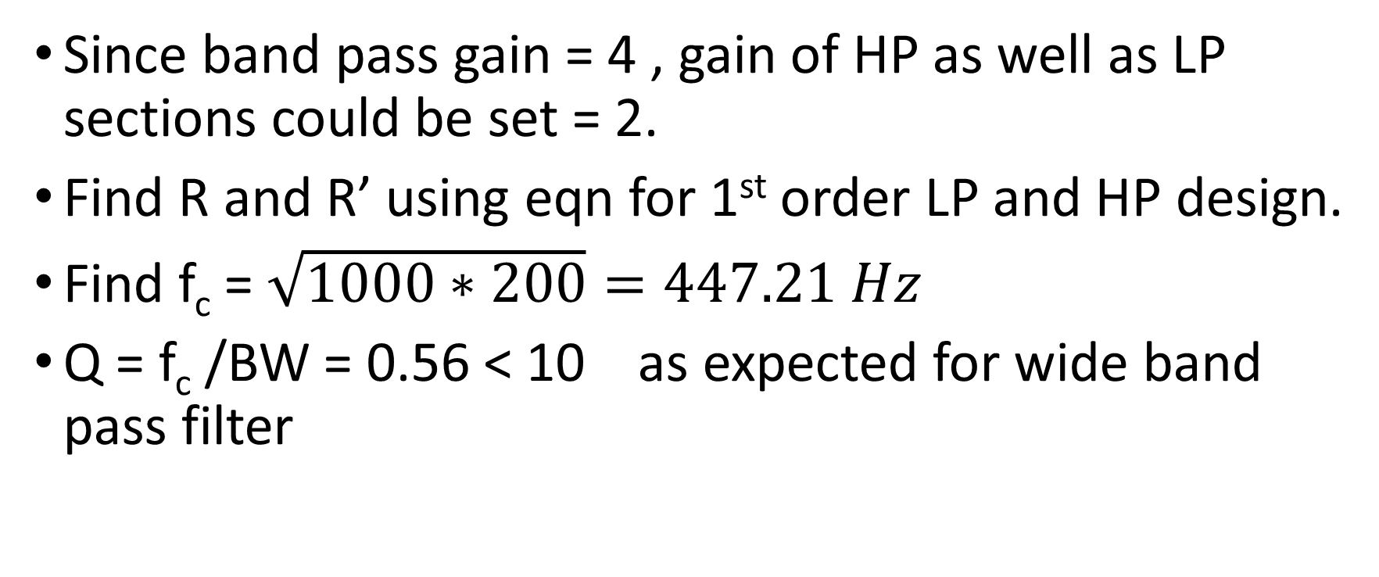
Since band pass gain = 4 , gain of HP as well as LP sections could be set = 2.
Find R and R’ using eqn for 1st order LP and HP design.
Find f_{c} = $\sqrt{1000∗200}=447.21 Hz$
Q = f_{c} /BW = 0.56 < 10 as expected for wide band pass filter

Slide 20
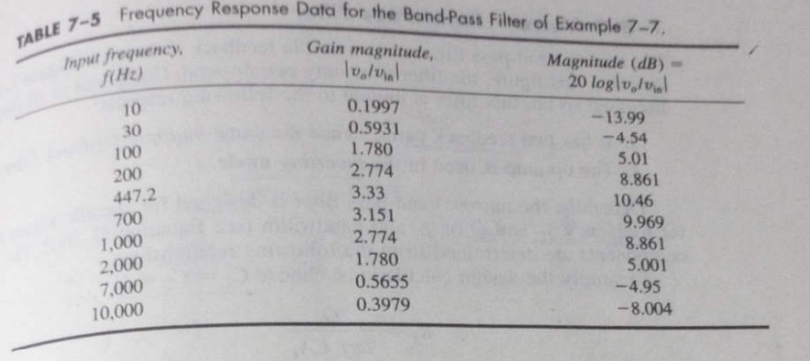

Slide 21
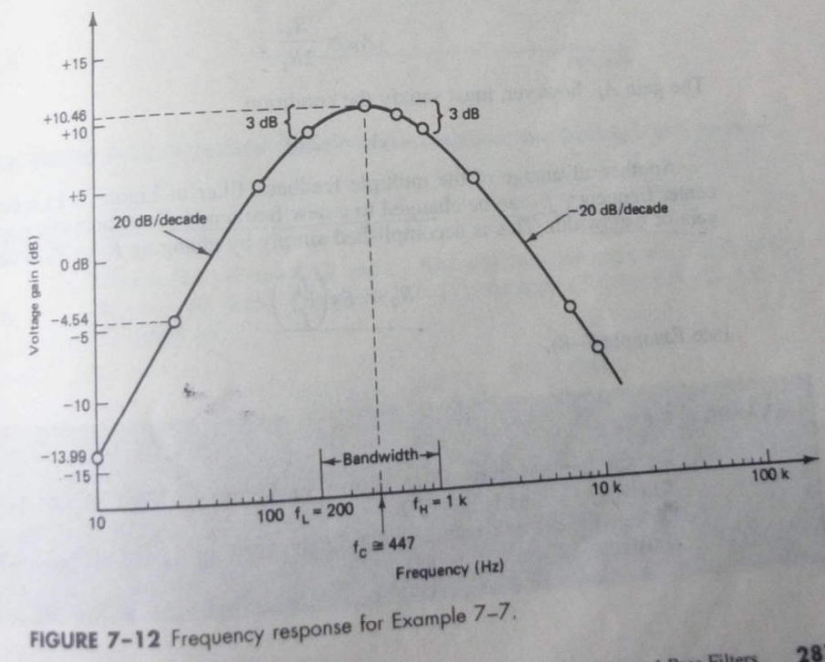

Slide 22
2nd order BPF (using single op amp)

Slide 23
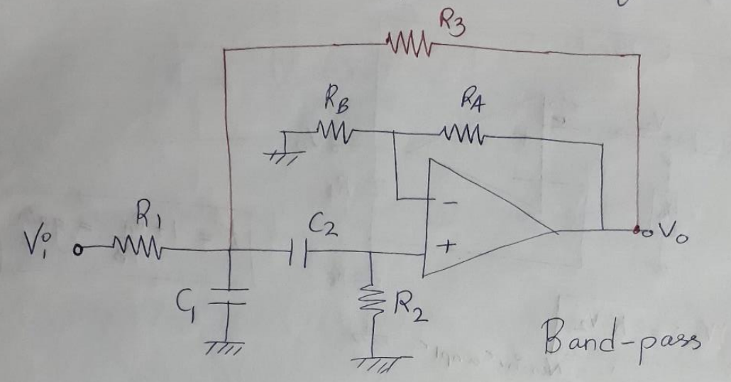
2nd order BPF

Slide 24
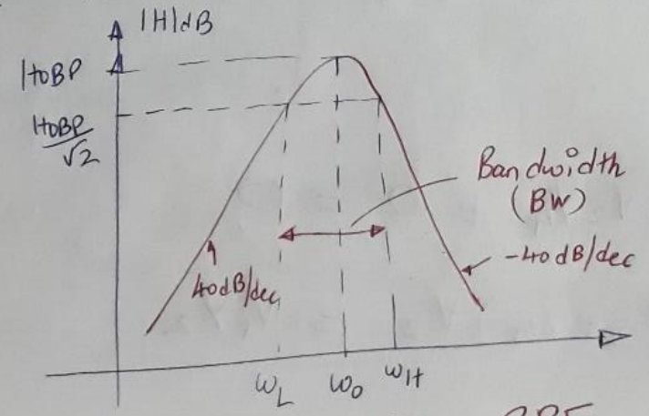
Consist of an RC stage followed by CR stage to synthesis a BP block and a gain block to provide +ve f/b via R3.
Frequency response of BPF with H_{OBP} = resonant gain or BP gain and ω₀ = resonance or peak freq.

Slide 25
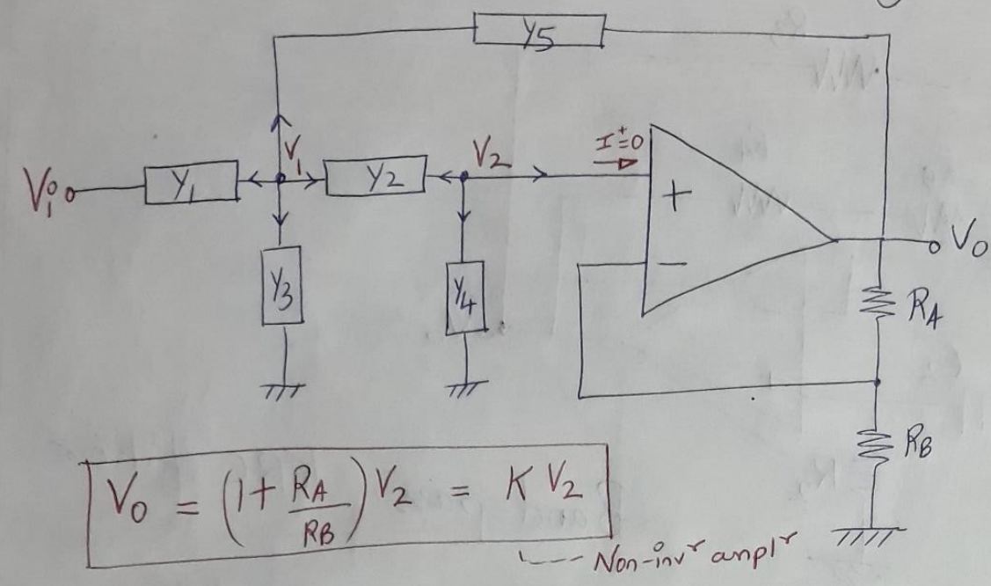
Derivation for f₀ and quality factor Q

Slide 26
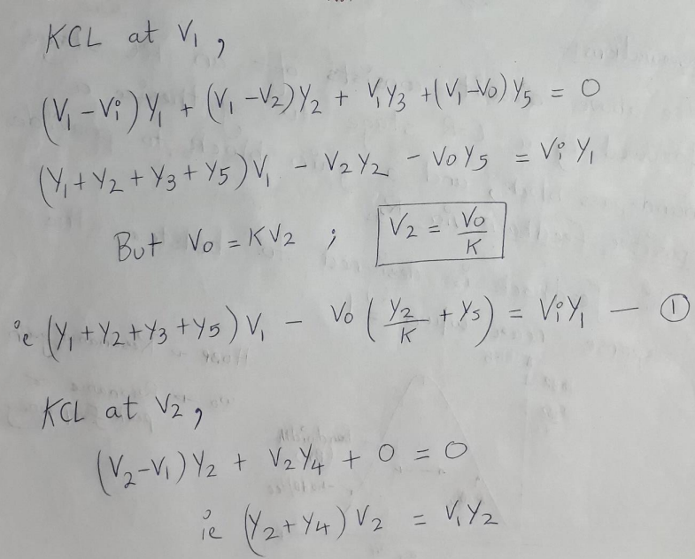

Slide 27
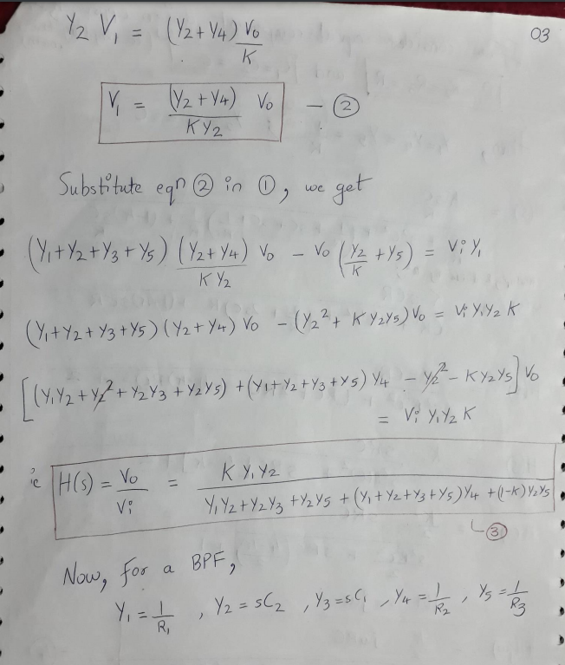

Slide 28
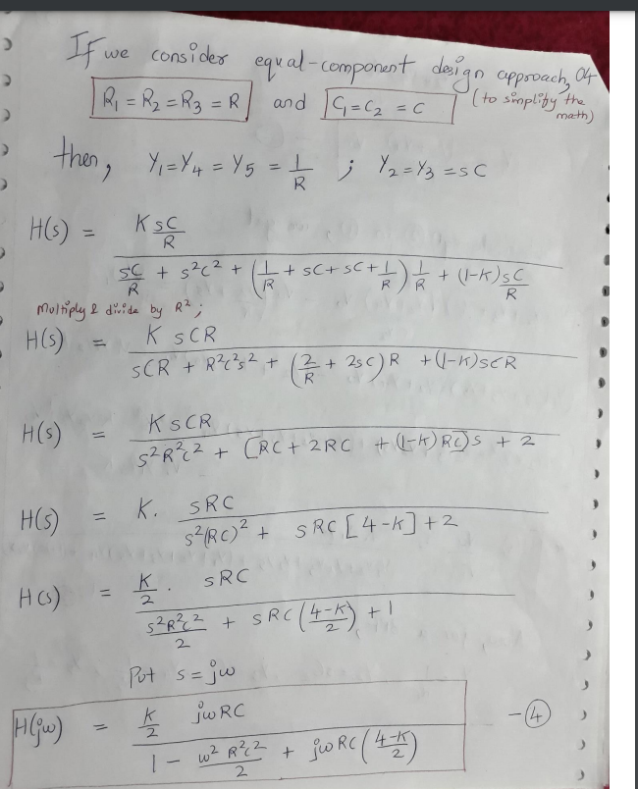

Slide 29
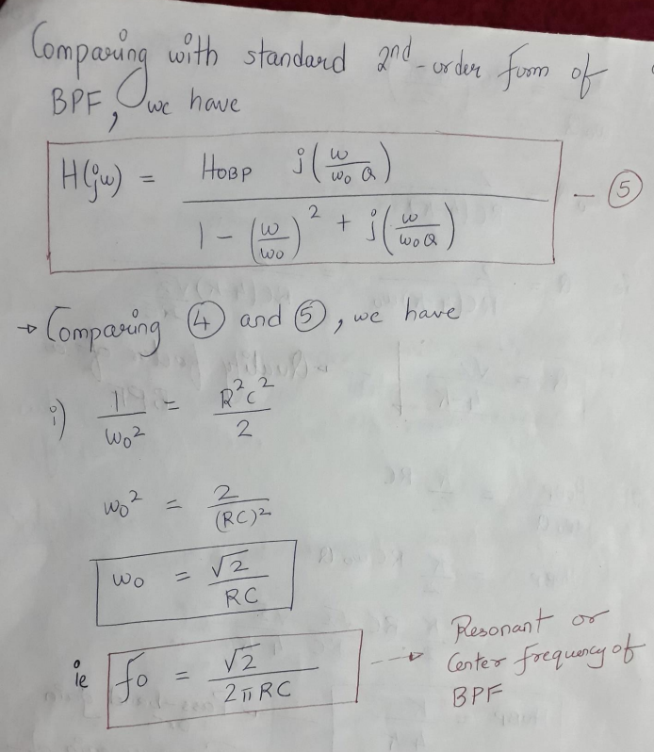

Slide 30
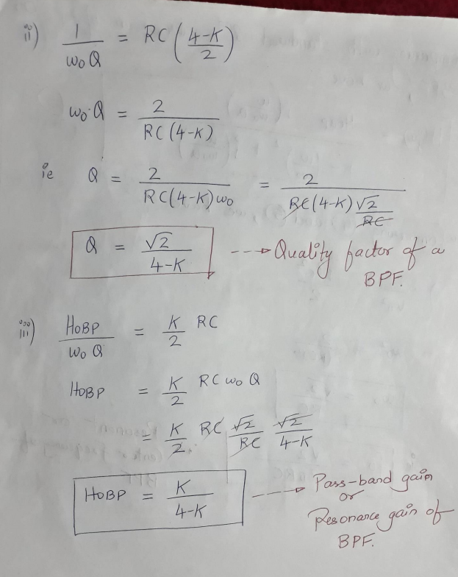

Slide 31
K = op amp gain =A_{F} H_{oBP} = A_{FT} total pass band gain of BPF.

Slide 32
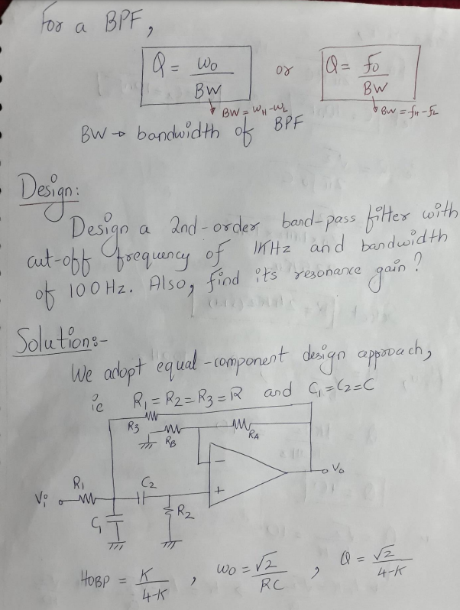

Slide 33
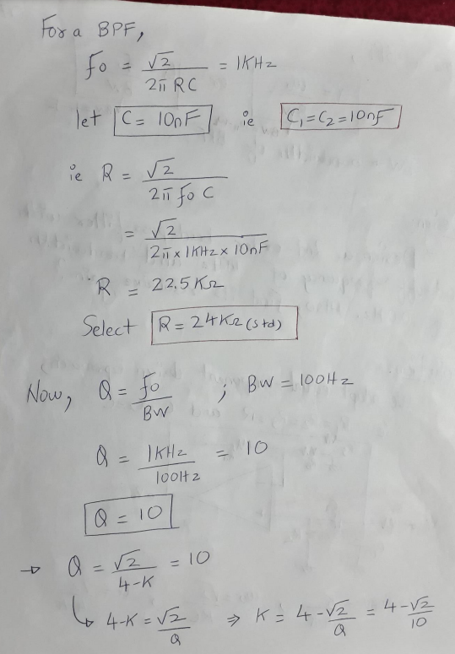

Slide 34
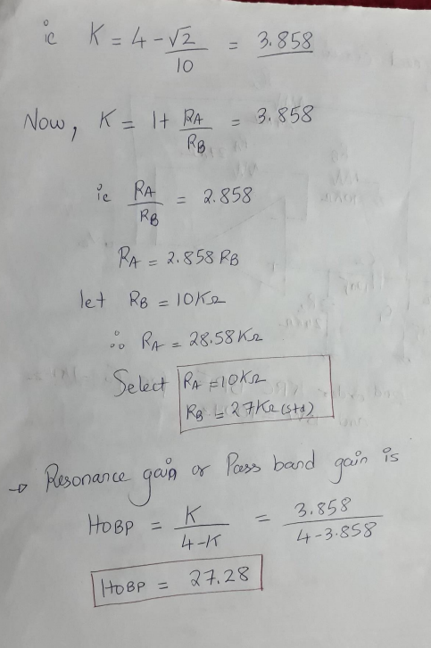

Slide 35
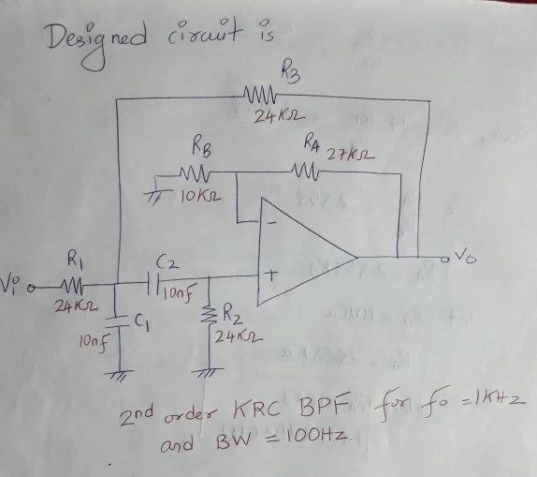

Slide 36
Narrow Band Pass Filter

Slide 37
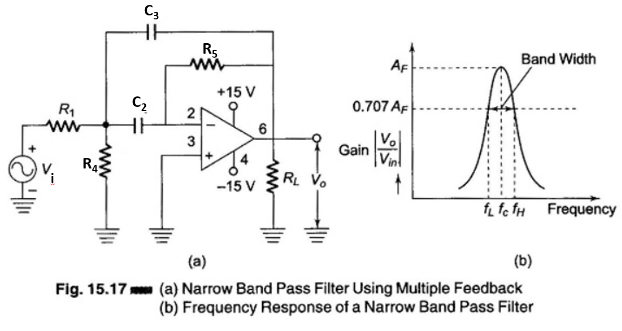
Narrow Band Pass Filter
The narrow Band Pass Filter Circuit using multiple feedback is shown in Fig.

Slide 38
Filter uses only one opamp.
This filter is unique in the following respects.
It has two feedback paths, which is why it is called a multiple feedback
The opamp is used in the inverting mode.
Generally a narrow band pass filter is designed for specific values of centre frequency f_{c} and Q, or f_{c} and band width.

Slide 39
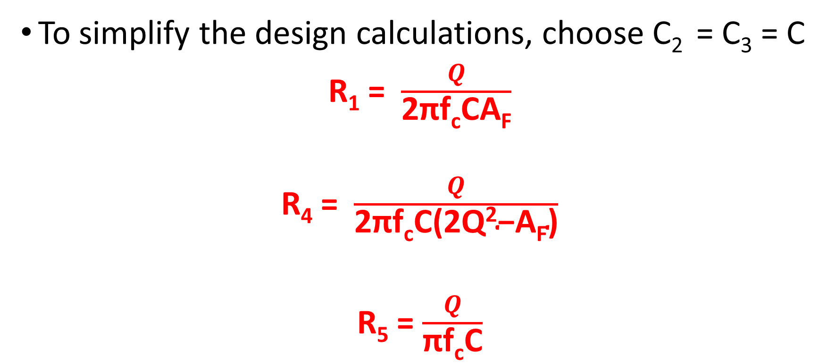
Design
To simplify the design calculations, choose C₂ = C₃ = C
R₁ = $\frac{Q}{\text{2}\text{π}\text{f}\text{c}\text{CA}\text{F}}$
R₄ = $\frac{Q}{\text{2}\text{π}\text{f}\text{c}\text{C}\text{(}\text{2}\text{Q}\text{2}\text{−}\text{A}\text{F}\text{)}}$
R₅ = $\frac{Q}{\text{π}\text{f}\text{c}\text{C}}$

Slide 40
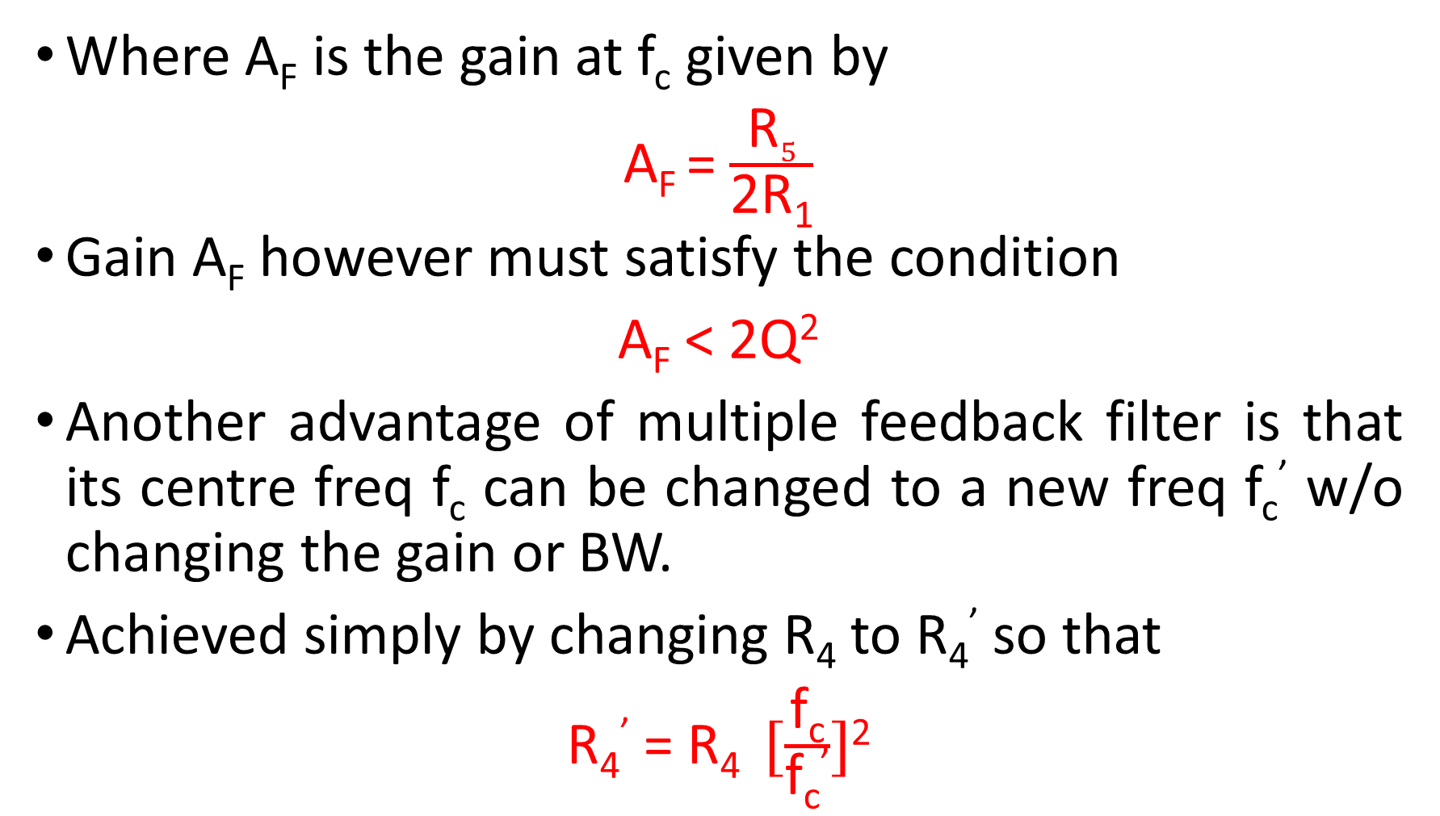
Where A_{F} is the gain at f_{c} given by
A_{F} = $\frac{\text{R}5}{\text{2}\text{R}\text{1}}$
Gain A_{F} however must satisfy the condition
A_{F} < 2Q²
Another advantage of multiple feedback filter is that its centre freq f_{c} can be changed to a new freq f_{c}’ w/o changing the gain or BW.
Achieved simply by changing R₄ to R₄’ so that
R₄’ = R₄ $[\frac{\text{f}\text{c}}{\text{f}\text{c}\text{’}}]$²

Slide 41
NUMERICALS
a) Design a band pass filter with f_{c} =1 KHz, Q=3 and A_{F} = 10.
b) Change the centre freq to 1.5KHz keeping A_{F} and BW constant.

Slide 42
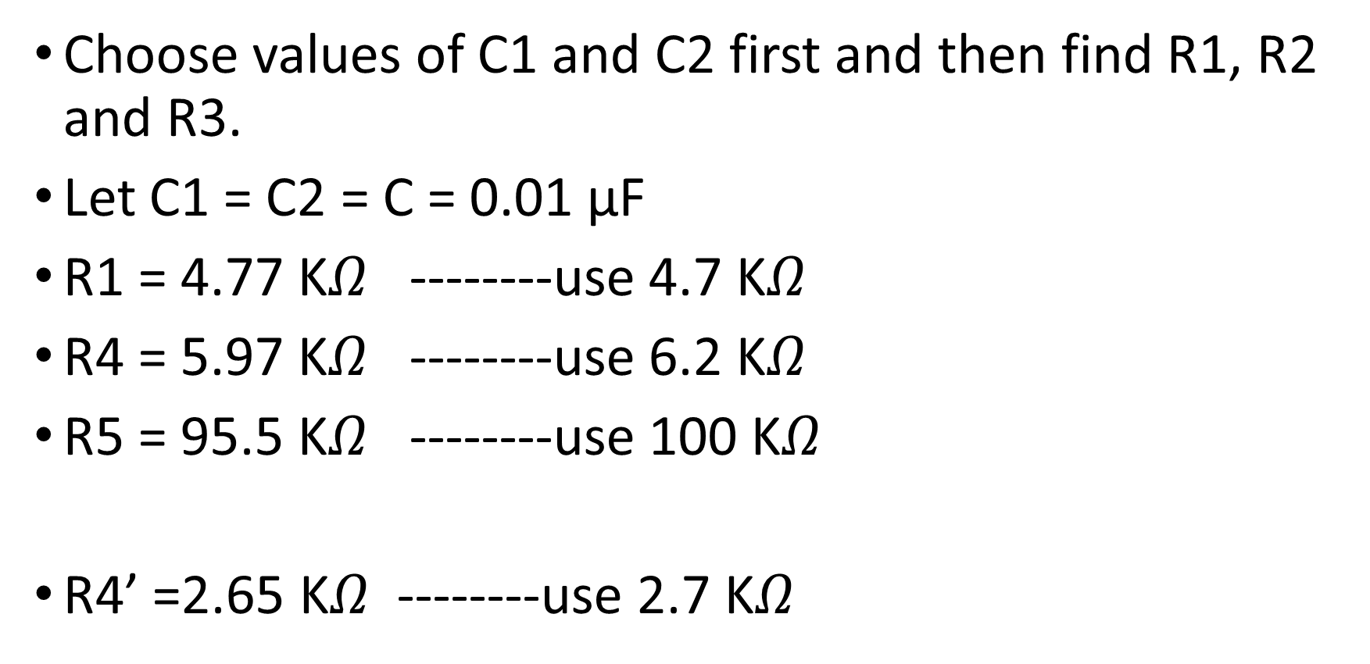
Choose values of C1 and C2 first and then find R1, R2 and R3.
Let C1 = C2 = C = 0.01 µF
R1 = 4.77 K$Ω$ --------use 4.7 K$Ω$
R4 = 5.97 K$Ω$ --------use 6.2 K$Ω$
R5 = 95.5 K$Ω$ --------use 100 K$Ω$
R4’ =2.65 K$Ω$ --------use 2.7 K$Ω$

Slide 43
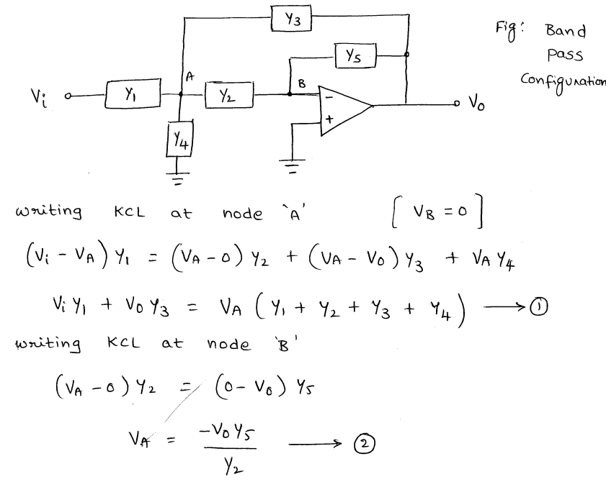
Narrow Band Pass Filter- Derivation

Slide 44
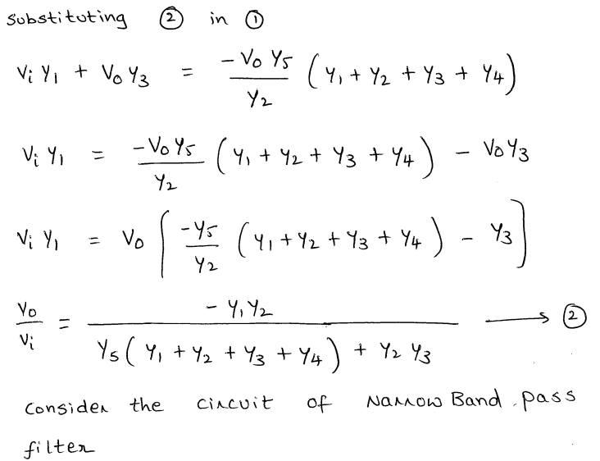

Slide 45
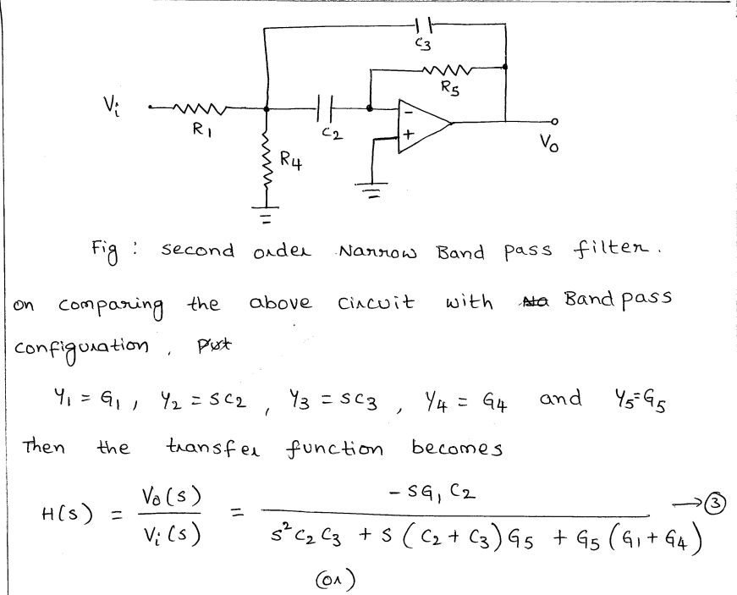

Slide 46
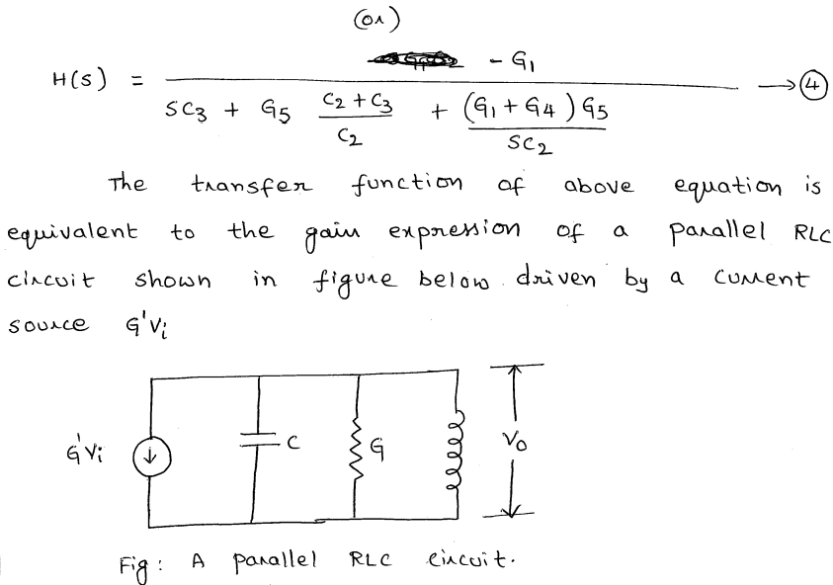

Slide 47
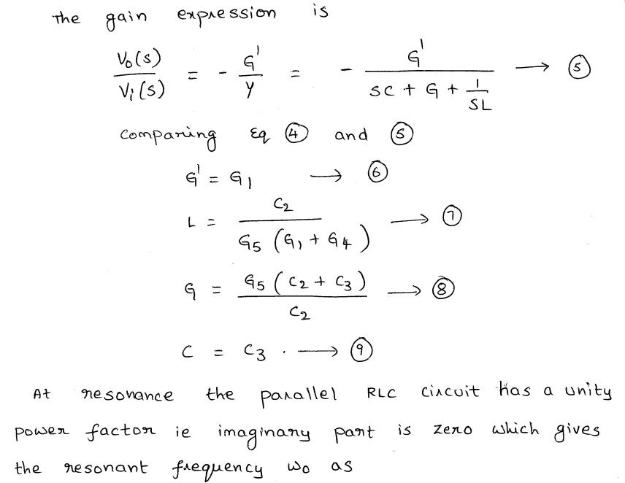

Slide 48
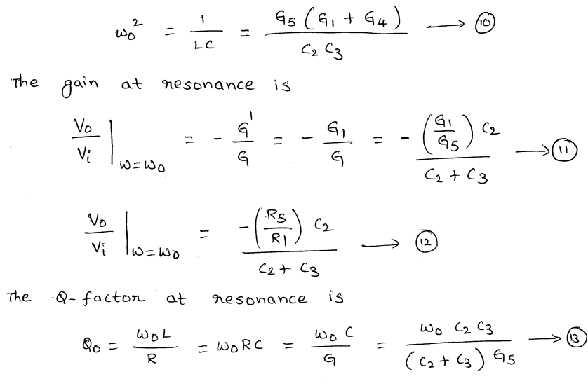

Slide 49
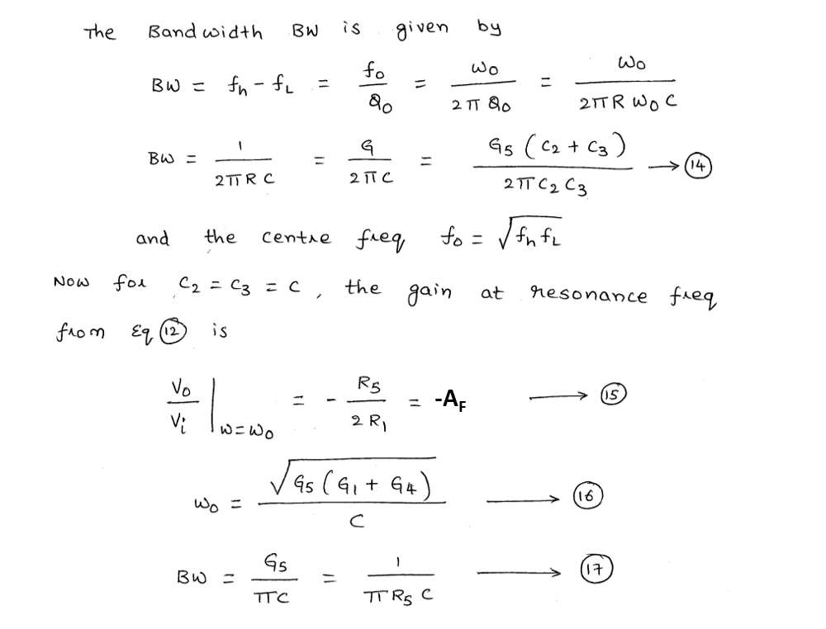

Slide 50
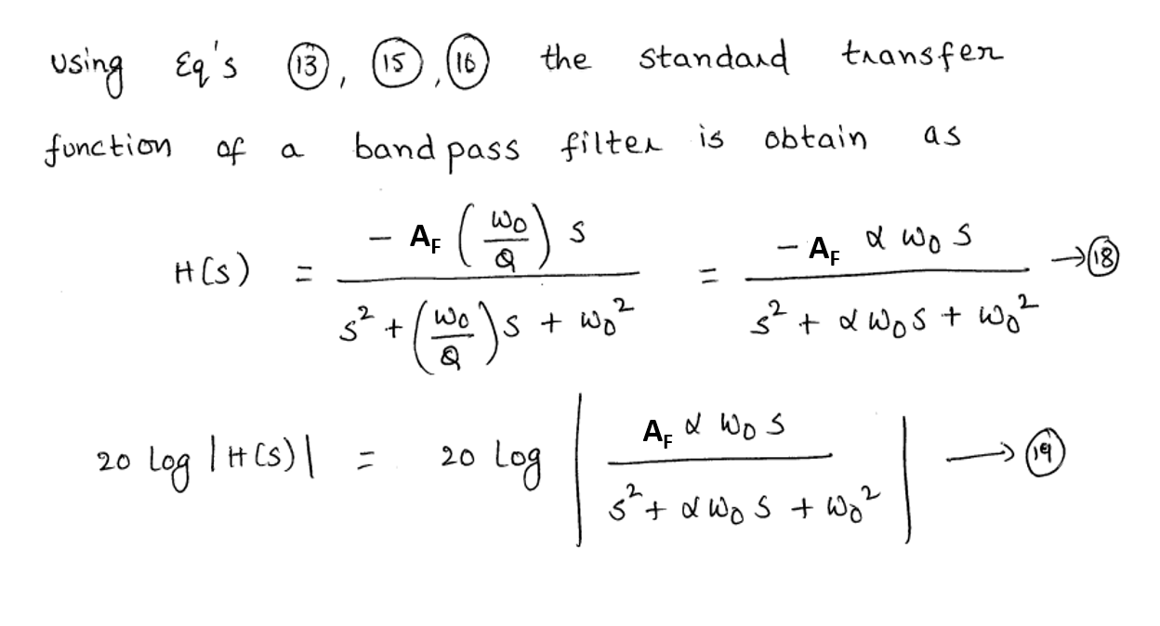

Slide 51
